Slide 1
Week 3a: Graphics pipeline

Slide 2
Last class
3D coordinate system
Points & Vectors
Translate
Rotate
Scale
Dot & Cross product

Slide 3
This class
Raytracing vs Rasterization
GPU internals
Graphic API’s
HLSL (GPU language)
Forward/Deferred rendering

Slide 4

Course schedule
 | Monday | Thursday
Week 1 : 12/02 | Introduction | C#/Unity Lab
Week 2 : 19/02 | 3D reasoning | 3D Lab
Week 3 : 26/02 | Basic Pipeline | Lab
Week 4 : 04/03 | Textures Normal maps | Post processing / lab
Week 5 : 11/03 | Camera’s Light | lab
Week 6 : 18/03 | Advanced pipeline | Advanced pipeline lab
Week 7 : 25/03 | Materials Aliasing | Materials Lab
Week 8 : 15/04 | Procedural generation | Procedural generation lab
Week 9 : 22/04 | Project explanation | Project lab
Week 10 : 29/04 | Guest Lecture Project Labs | Guest Lecture Project Labs
Week 11 : | Revision | Revision
Highly likely to change ☹

Slide 5
This class
→ Raytracing vs Rasterization ←
GPU internals
Graphic API’s
HLSL (GPU language)
Forward/Deferred rendering

Slide 6
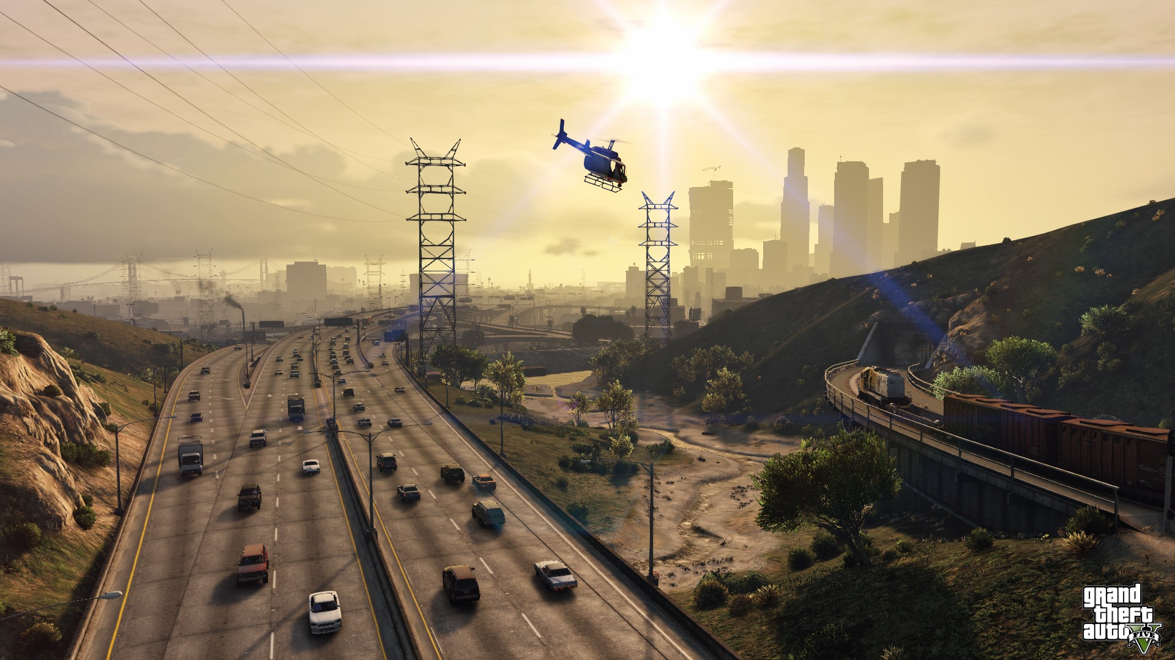
Remember: we want to understand why a pixel has it’s color

Slide 7
We want to render an image
What is rendering again?
How would we approach this problem?

Slide 8
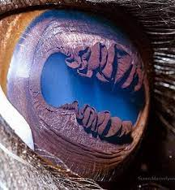
We want to make an image as we see real life
We need to know how our eyes/cameras make images
This is the physics of light transport

Slide 9
Light transport
To recreate what our eyes see in reality…
…have to understand how reality works

Slide 10
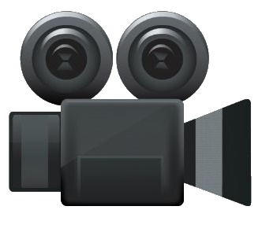

Light transport
Light hits an object
That light bounces
It enters our eye

Slide 11
Light transport
Light hits an object
That light bounces
In many directions
Some materials more than others
Some of it enters our eye

Slide 12
Light transport
Light hits an object
That light bounces
In many directions
Most hit another object (and bounce again)
Some of it enters our eye

Slide 13
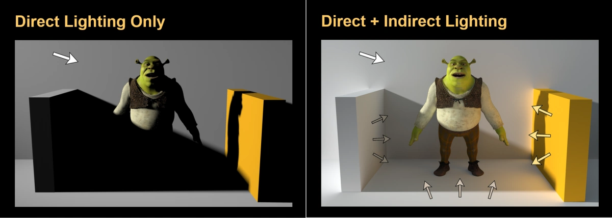
Light transport

Slide 14
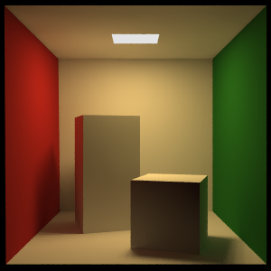
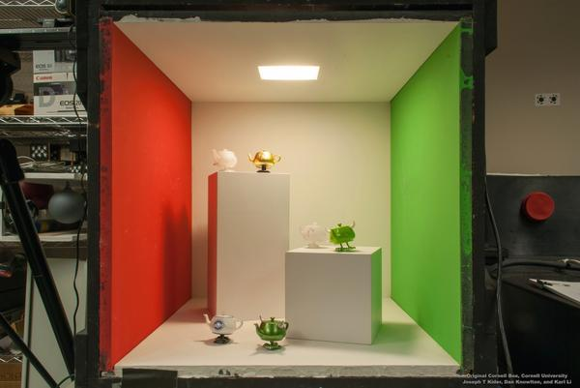
Fun fact
This exist in reality
Can measure with a camera
Compare render for accuracy

Slide 15
How do we simulate that on a computer?
Only a tiny fraction of light enters the camera
Very inefficient

Slide 16
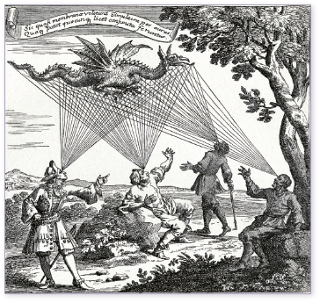
One idea : raytracing

Slide 17
We turn around the arrows
From the camera (pixel)
Fire a ray
Find the first object it hits
Find the light entering it
3
2
1
2

Slide 18
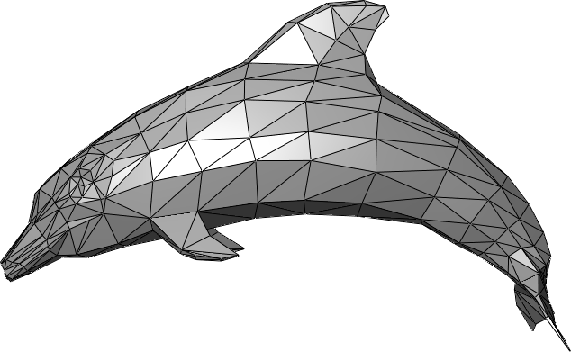
Another idea : rasterization

Slide 19
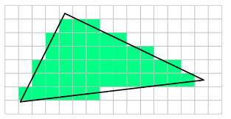
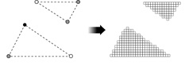
Rasterization
We transform the geometry so it’s in the right place
We chop it into pixels (fragments)
We color those fragments

Slide 20
Pros and cons
Raytracing
Good quality (multiple rays per pixels)
Easy implementation (at the start)
Manages smoke, mirrors
Bad performance
Raytracing
Ok quality (one fragment per pixels)
Hard implementation (at the start)
Difficult smoke, mirrors
Good performance
* Lots of simplifications and lies on this slide

Slide 21
What is your graphics card made for?

Slide 22
Pros and cons
Raytracing
Good quality (multiple rays per pixels)
Easy implementation (at the start)
Manages smoke, mirrors
Bad performance
Rasterization
Ok quality (one fragment per pixels)
Hard implementation (at the start
Difficult smoke, mirrors
Good performance
* Lots of simplifications and lies on this slide

Slide 23
Pros and cons
Raytracing
Good quality (multiple rays per pixels)
Easy implementation (at the start)
Manages smoke, mirrors
Bad performance
Rasterization
Ok quality (one fragment per pixels)
Hard implementation (at the start
Difficult smoke, mirrors
Good performance
* Lots of simplifications and lies on this slide

Slide 24
Pros and cons
Raytracing
Good quality (multiple rays per pixels)
Easy implementation (at the start)
Manages smoke, mirrors
Bad performance
Rasterization
Ok quality (one fragment per pixels)
Hard implementation (at the start
Difficult smoke, mirrors
Good performance
* Lots of simplifications and lies on this slide

Slide 25
Pros and cons
Raytracing
Good quality (multiple rays per pixels)
Easy implementation (at the start)
Manages smoke, mirrors
Bad performance
Rasterization
Ok quality (one fragment per pixels)
Hard implementation (at the start
Difficult smoke, mirrors
Good performance
* Lots of simplifications and lies on this slide

Slide 26
GPU’s were made for rasterizaton
It never was a choice
Realtime raytracing was impossible
So we use(d) rasterization
*Nowadays there is raytracing on the gpu
For small things : special fx (smoke, etc…)

Slide 27
This class
Raytracing vs Rasterization
→ GPU internals ←
Graphic API’s
HLSL (GPU language)
Forward/Deferred rendering

Slide 28
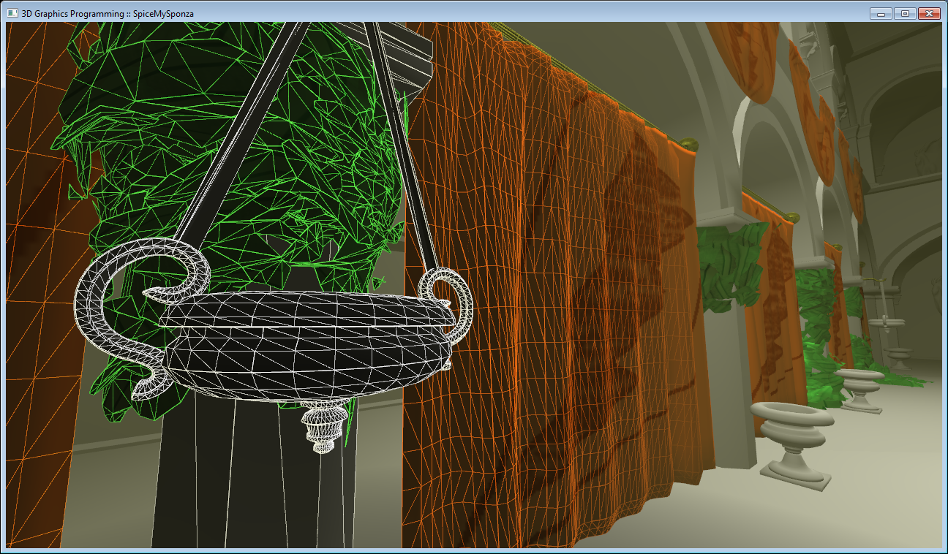
GPU’s draw meshes
A mesh is a surface made of triangles

Slide 29
GPU’s draw meshes
A triangle is made of 3 vertices
A vertex (singular) is at least a position

Slide 30
GPU’s draw meshes
We make more complicated shapes by adding triangles
Here : a rectangle

Slide 31




GPU Pipeline
Transform vertices
Rasterize
Calculate pixel color

Slide 32
Can someone give an example of “transform vertices”?
Transform vertices
Rasterize
Calculate pixel color

Slide 33
Can someone give an example of “calculate pixel color”?
Transform vertices
Rasterize
Calculate pixel color

Slide 34
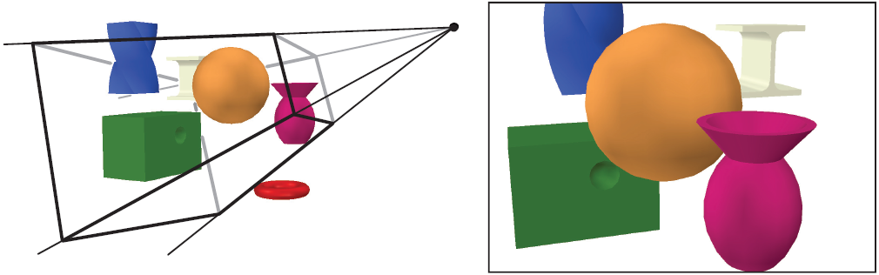
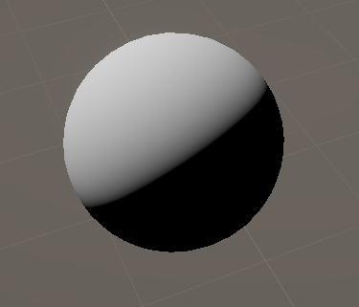
GPU Pipeline
Transform vertices
Rasterize
Calculate pixel color

Slide 35
This pipeline is programmable through shaders
Rasterizer
(not programmable)
Vertex shader
Fragment shader

Slide 36
Rasterizer also interpolates vertex attributes
Attribute : can be anything we want
Position (always, why?)
Normal
Texture coordinates
Color
....

Slide 37
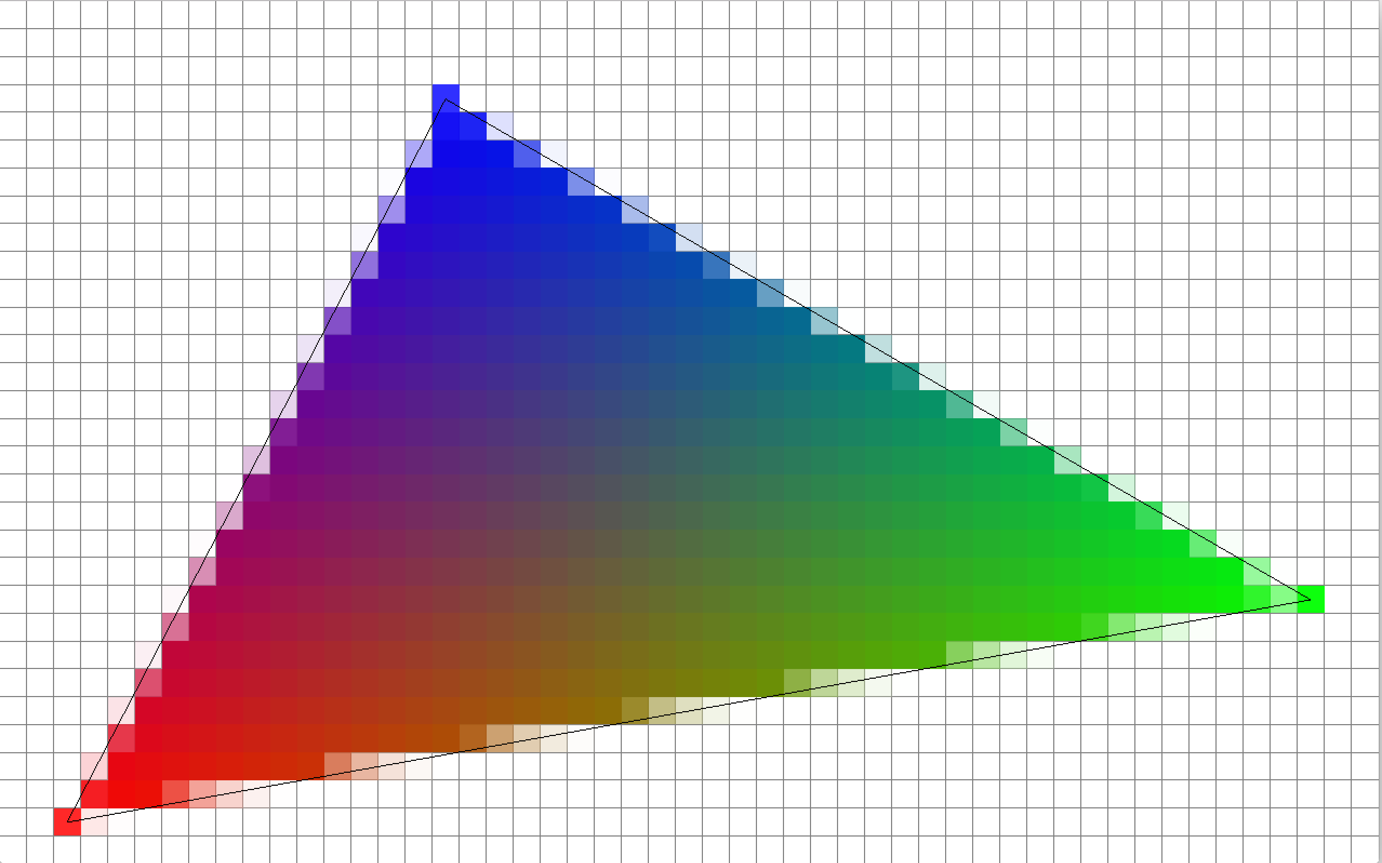
Interpolation (linear)
(1, 1)
(0, 0)

Slide 38
Is position interpolated? Why (not)?

Slide 39
Of course! Fragments need a position

Slide 40
One gotcha : primary visibility
We’re interested in the object closest to the camera

Slide 41
Primary visibility : raytracing
For raytracing it’s the closest intersection
4
3
2
1

Slide 42
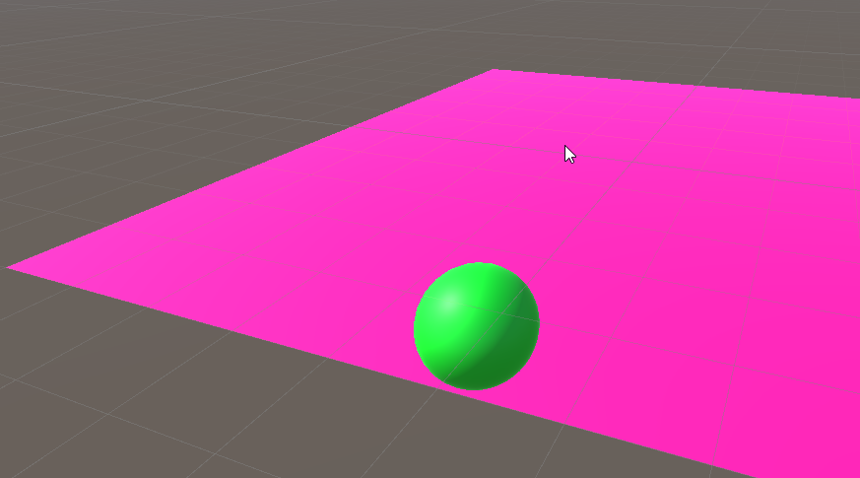
Primary visibility : rasterization
Objects are drawn on top of eachother
Eg closest to camera
Last object “overwrites” pixels

Slide 43
This is not correct

Slide 44
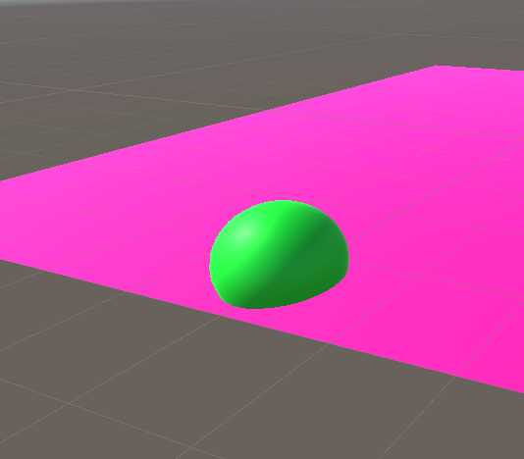
This is correct

Slide 45
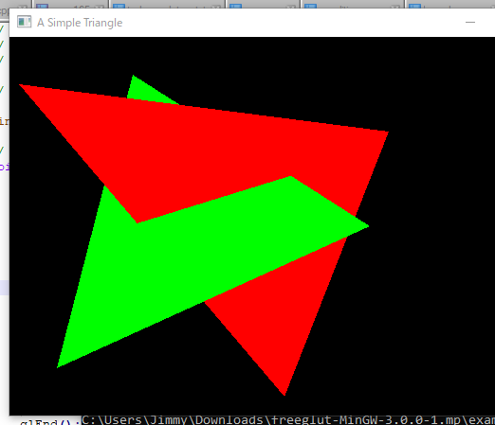
We could sort triangles
But this would also not work
Can’t handle case below

Slide 46
Anyone have an idea of what would work?

Slide 47
Let’s use a depth buffer

Slide 48
Create a 2D texture with depth information
Empty because we didn’t draw anything yet

Slide 49

Draw object
It’s the first object, so it’s fully visible

Slide 50
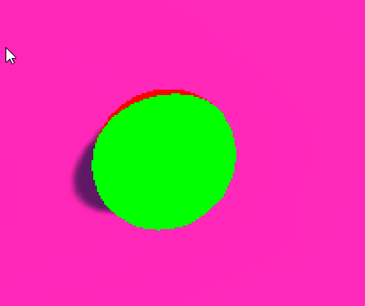
Draw second object
Check which pixels are closer
The hardware does this for us
Closer to the camera : this passes
Further from the camera : this fails

Slide 51
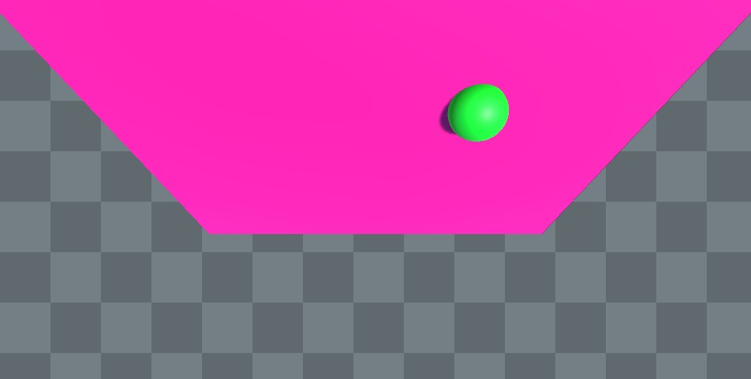
Only run the fragment shader on passing pixels

Slide 52
Why do we always run the vertex shader?

Slide 53

And don’t forget to write depth values

Slide 54
What are your questions?

Slide 55
Funny anecdote about depth buffer
Also, this is a nice example of how raytracing can be much simpler

Slide 56
This class
Raytracing vs Rasterization
GPU internals
→ Graphic API’s ←
HLSL (GPU language)
Forward/Deferred rendering

Slide 57
Graphics API’s
Vulkan, OpenGL, DirectX
Can draw a mesh
What else do they have to do?

Slide 58
Other (that unity helps us with)
Clear a texture (set solid color)
Create / set contents of textures
Create / set contents of meshes
Create / set contents of uniform buffers (parameters)
Create (compile) shaders

Slide 59
Anything that is missing?

Slide 60
A lot of surprising things are not in our API!
Lights
Shadows
Animations
Camera’s
We all do this ourself!

Slide 61
What are your questions?

Slide 62
This class
Raytracing vs Rasterization
GPU internals
Graphic API’s
HLSL (GPU language)
Forward/Deferred rendering

Slide 63
HLSL
High Level Shading Language
Originally made for DirectX
Makes intermediate language
Can translate to Vulkan, OpenGL

Slide 64
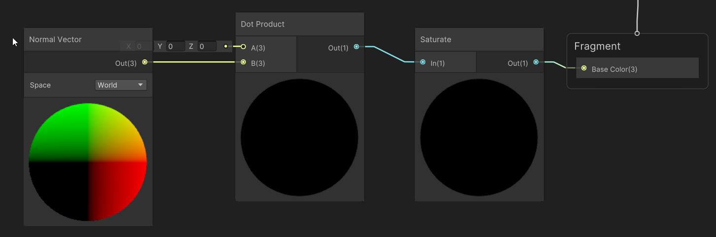
Shader Graph
Translated to HLSL
Made primarily for artists
Prefer writing HLSL (will clarify with labs) fixed4 outColor = saturate(dot(N, L));

Slide 65
Anatomy of a Unity Shader
Shader "Unlit/NewUnlitShader"
{ Everything is in a block “Shader”, with the name of our shader

Slide 66
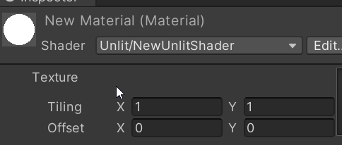
Properties
Shader "Unlit/NewUnlitShader"
{
Properties
{
_MainTex ("Texture", 2D) = "white" {}
} Properties are variables accessible in the inspector
For artists (and us)
Don’t forget to make a material!

Slide 67
Datatypes : vectors
float3 bar.xyz = foo.zyy;
float2 baz = bar.xy;
This is called swizzling
Useful for conversions

Slide 68
Datatypes : vectors
fixed4 four;
fixed3 three;
fixed2 two;
fixed one;
half4 four;
half3 three;
half2 two;
half one;
float4 four;
float3 three;
float2 two;
float one;
All are vector types of floating point numbers
Precision (might) decrease going left to right
Just use floats

Slide 69
Anatomy of a Unity Shader
Shader "Unlit/NewUnlitShader"
{
Properties
{
_MainTex ("Texture", 2D) = "white" {}
}
SubShader
{
Subshader: allows different implementations (different hardware)
We will only ever have one

Slide 70
Inside Subshader
Shader "Unlit/NewUnlitShader"
{
Properties
{
_MainTex ("Texture", 2D) = "white" {}
}
SubShader
{
Subshader: allows different implementations (different hardware)
We will only ever have one

Slide 71
SubShader : Tags
SubShader
{
Tags { "RenderType"="Opaque" }
We’ll see this a lot more later
Basically tells unity *when* to use this shader in it’s pipeline

Slide 72
Define Structs
struct appdata
{
float4 vertex : POSITION;
float2 uv : TEXCOORD0;
};
struct v2f
{
float2 uv : TEXCOORD0;
UNITY_FOG_COORDS(1)
float4 vertex : SV_POSITION;
};
Appdata : incoming vertex structure
V2f : data going (interpolated) from vertex shader to pixel shader

Slide 73
Vertex shader
v2f vert (appdata v)
{
v2f o;
o.vertex = UnityObjectToClipPos(v.vertex);
o.uv = TRANSFORM_TEX(v.uv, _MainTex);
UNITY_TRANSFER_FOG(o,o.vertex);
return o;
}
Takes an appdata, outputs a v2f

Slide 74
Sshhhh, the gpu is rasterizing
Rasterizer
(not programmable)
Vertex shader
Fragment shader

Slide 75
Fragment shader
fixed4 frag (v2f i) : SV_Target
{
// sample the texture
fixed4 col = tex2D(_MainTex, i.uv);
// apply fog
UNITY_APPLY_FOG(i.fogCoord, col);
return col;
}
Takes an interpolated v2f, outputs a fixed4 (Vector4, color)

Slide 76
HLSL is really straightforward
Like C, without pointers
No oop
No abstraction
The hard part is the graphics
(and Unity getting in the way)

Slide 77
This class
Raytracing vs Rasterization
GPU internals
Graphic API’s
HLSL (GPU language)
→ Forward/Deferred rendering ←

Slide 78
We have our shaders, we have our depth buffer
But our API doesn’t know about lights, materials
We need to build a pipeline
A pipeline is an algorithm to render the entire object
There are two types : forward & deferred

Slide 79
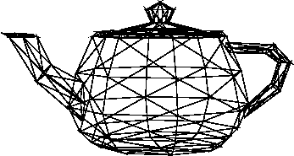
Forward rendering
For each object
Give it all the lights (in fragment shader)
Calculate final pixel color
+

Slide 80

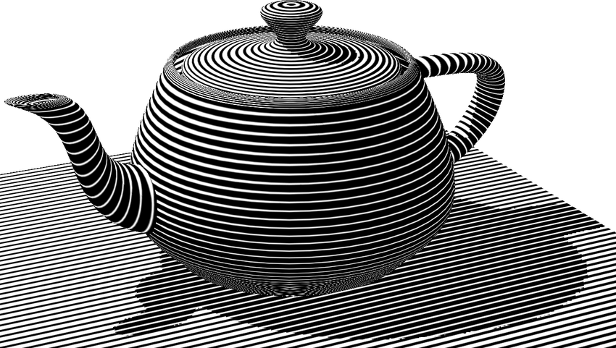
Results

Slide 81
Advantages
Each object can decide it’s material freely (fragment shader)
Works with transparent object (they don’t write depth)

Slide 82
Disadvantages
Lights affect the entire object
Potentially expensive shading before failing the depth test
Quite a lot of implementation
Practically, one material has 100’s of shaders : one light, 2 light
Different lights : permutations

Slide 83
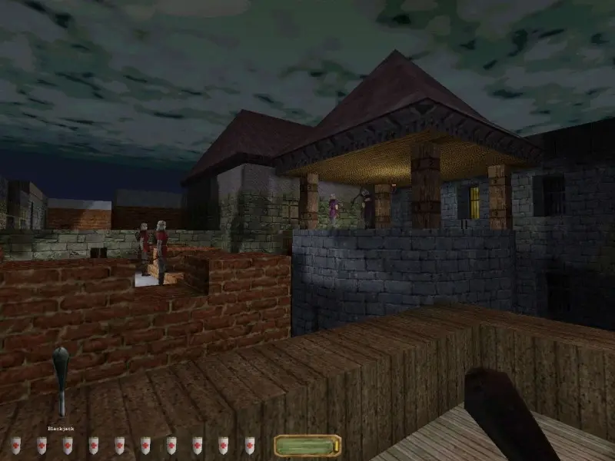
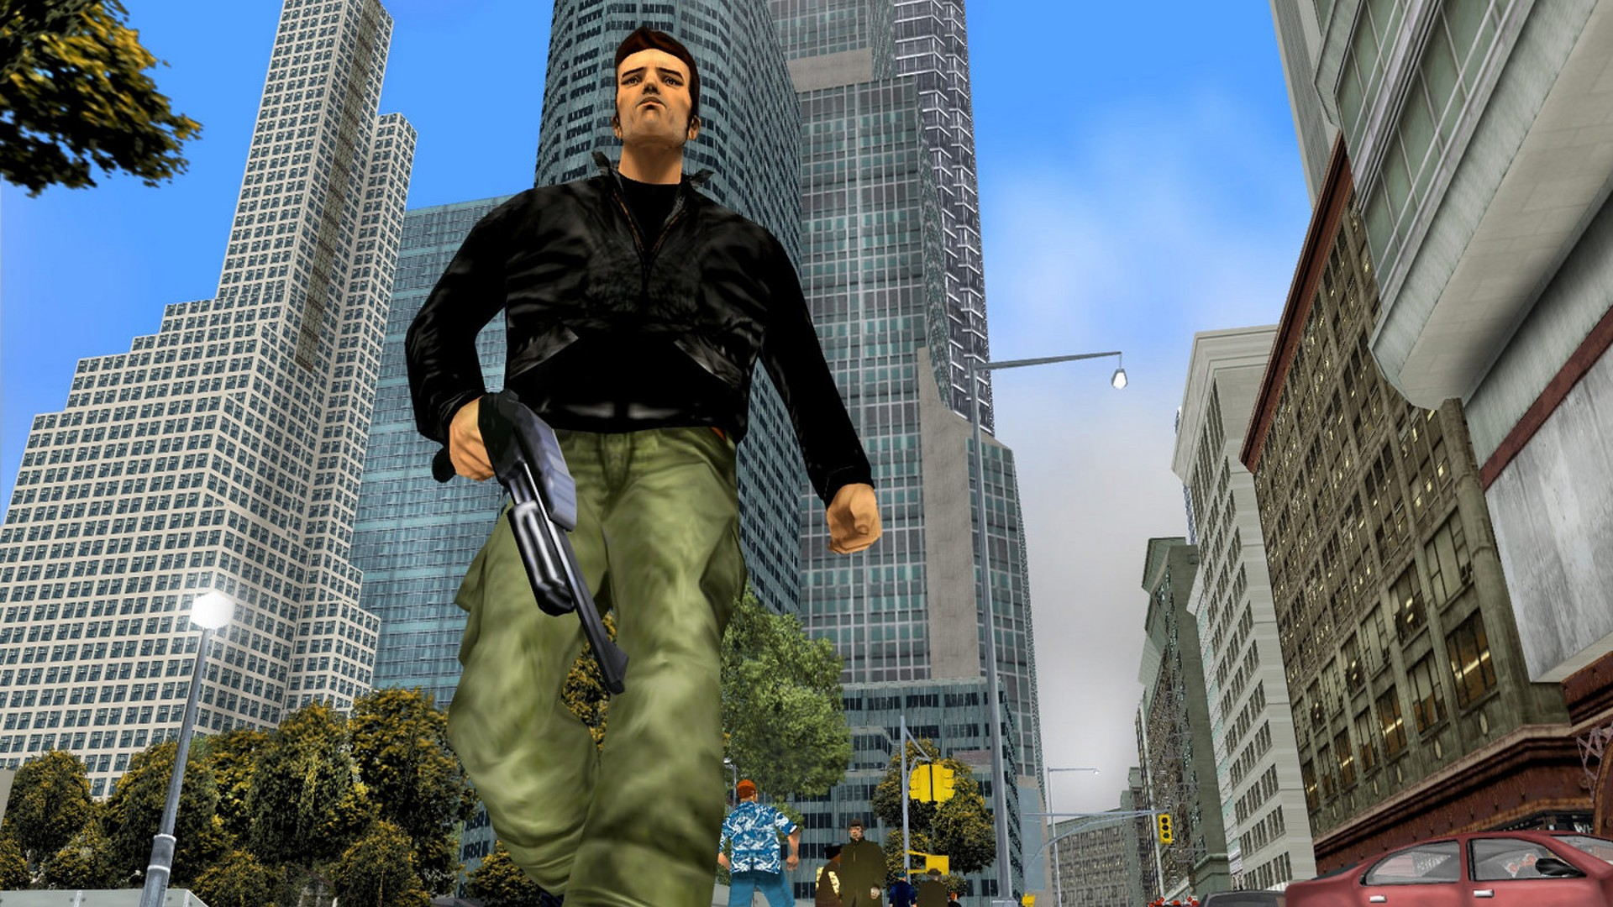
History
Everything was forward rendered

Slide 84
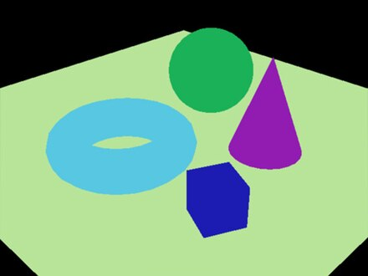
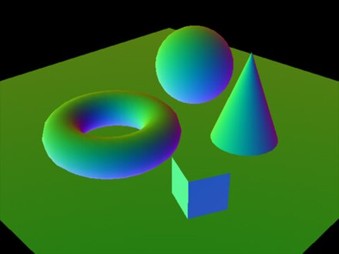
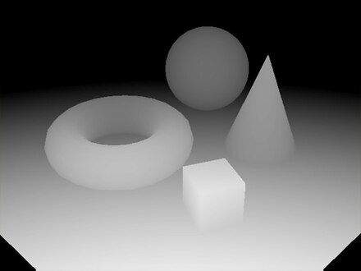
Deferred shading
For each object
Write shading information to buffers
Examples : color, normal

Slide 85
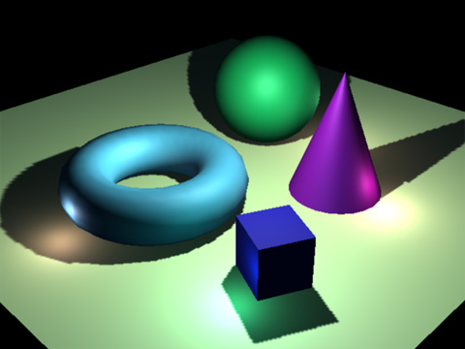
Deferred shading (2)
For each light
Render light
Fragment shader : read material parameters
Write : applied light

Slide 86
Advantages
Decouples lights and object
Lighting for visible (depth test passing) only
Lights on pixel level
Easy initial implementation

Slide 87
Disadvantages
Less freedom in materials (no special case per object)
Buffers can be large
No transparency ☹

Slide 88
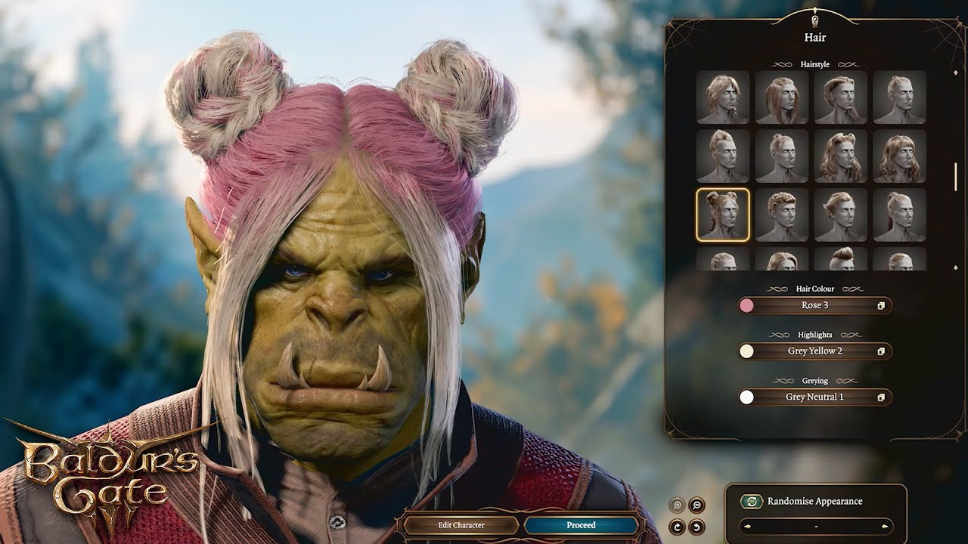
History
Since 2004-ish
Hand in hand with fully programmable shading
99% of realtime rendering is deferred (to some extent)

Slide 89
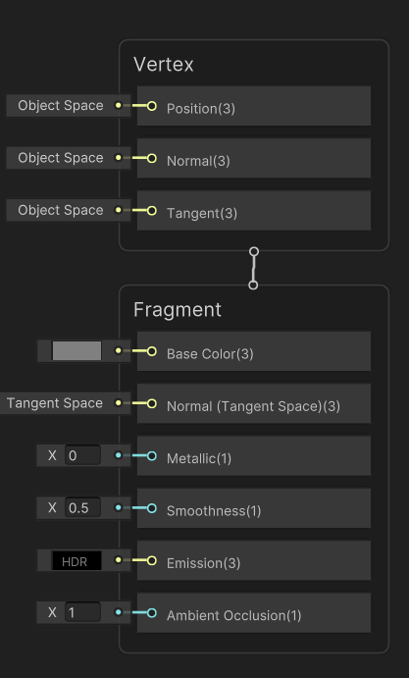
This is what Unity uses!
void surf (Input IN, inout SurfaceOutputStandard o)
{
// Albedo comes from a texture tinted by color
fixed4 c = tex2D (_MainTex, IN.uv_MainTex) * _Color;
o.Albedo = c.rgb;
// Metallic and smoothness come from slider variables
o.Metallic = _Metallic;
o.Smoothness = _Glossiness;
o.Alpha = c.a;
}

Slide 90
Anything unclear?

Slide 91
Recap
We can render by raytracing or rasterization
Realtime rendering uses rasterization
Vertices are transformed using a vertex shader
The rasterizer chops triangles into fragments
Fragments are shaded using a fragment shader
HLSL is how we program shaders
Forward rendering makes an object shade itself, using lights
Deferred rendering makes object write properties to gbuffers, and lights shade what they cover
Unity uses deferred shading (mostly)

Slide 92
Next lab
Going to write HLSL
Maybe some pipeline stuff

